Slide 1


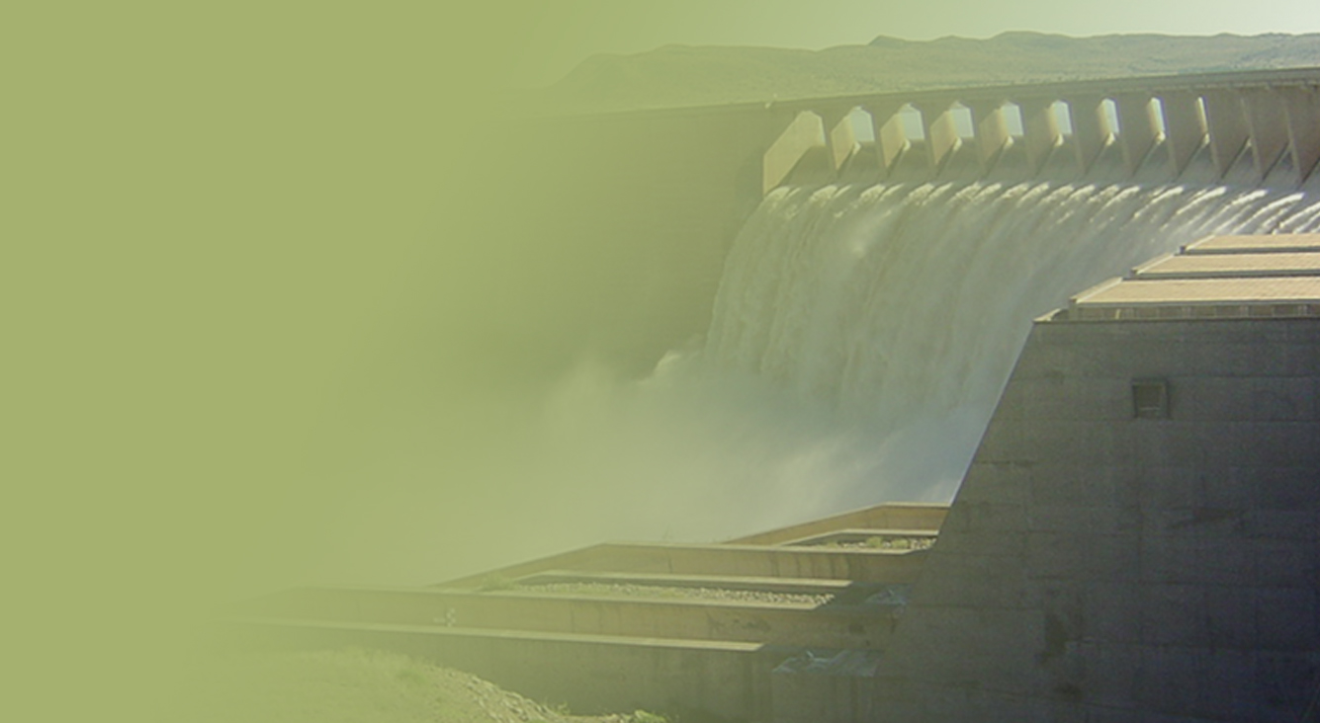
The Determination of Water Resources Classes and Resource Quality Objectives in the Breede-Gouritz WMA
TTG 2
Presented by: Barry Clark
Date: 12 March 2018
Venue: Graham and Rhona Beck Skills Centre, Robertson

Slide 2
Study Objectives
  Determine Water Resource Classes (WRCs)
  Determine Resource Quality Objectives (RQOs)
  Support Gazetting of Recommended Water Resources Classes and RQOs

Slide 3
Meeting Objectives
Present the methodology followed to prioritise Resource Units
Present the methodology followed to evaluate Resource Units
Present the draft Resource Quality Objectives for Resource Units

Slide 4
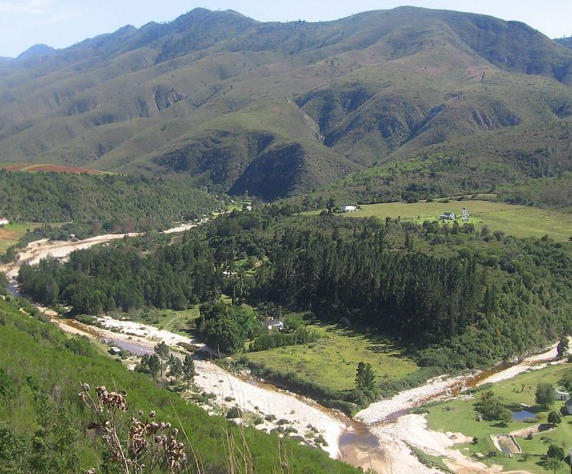

Overview of Study Progress

Slide 5
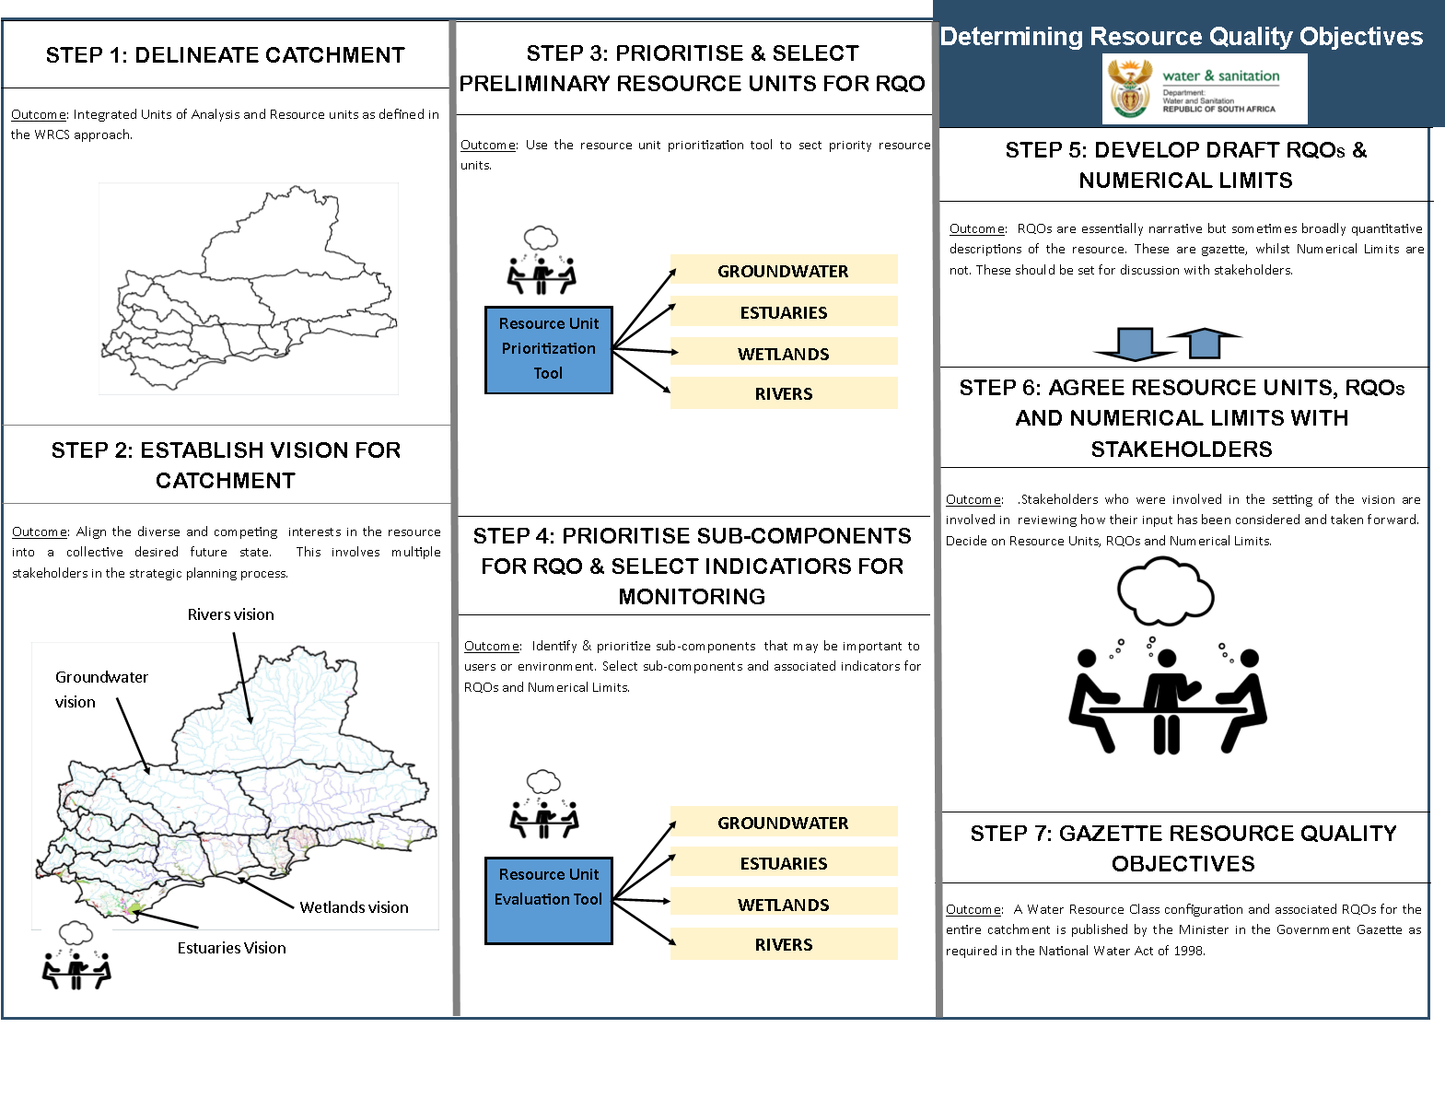
Study Status
DAMS
Draft
Complete
Draft
Complete
DAMS
Draft
Notes:
Erik to present progress, Reminder of two stage process (Classification followed be RQOs – but gazetted together). Link to RQOs? Then zoom in on the classification process

Slide 6
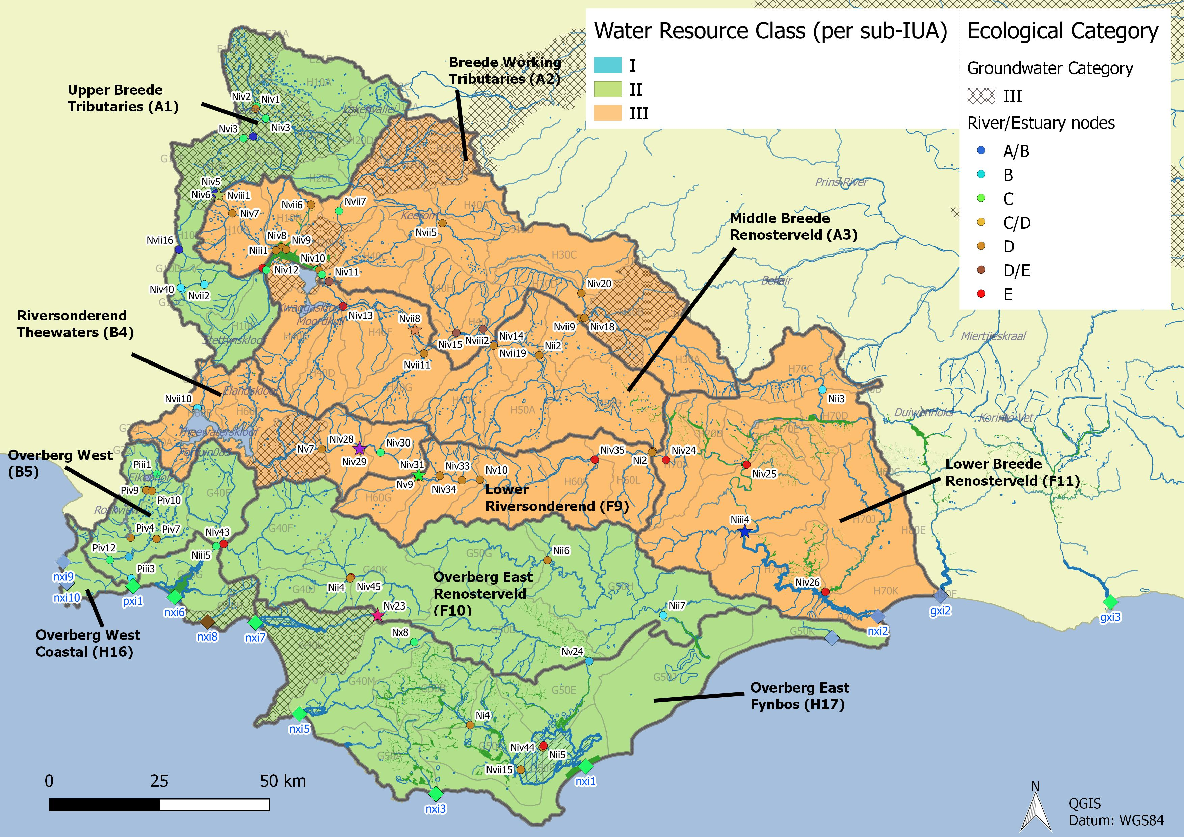
Integrated Units of Analysis and Nodes
Breede-Overberg Region

Slide 7
Breede-Overberg Region
Region | IUA | Spatially targeted
Breede Overberg | A1 Upper Breede Tributaries | II
 | A2 Middle Breede Renosterveld | III
 | A3 Breede Working Tributaries | III
 | B4 Riversonderend Theewaters | III
 | F9 Lower Riversonderend | III
 | B5 Overberg West | II
 | H16 Overberg West Coastal | II
 | F10 Overberg East Renosterveld | II
 | H17 Overberg East Fynbos | III
 | F11 Lower Breede Renosterveld | II

Slide 8
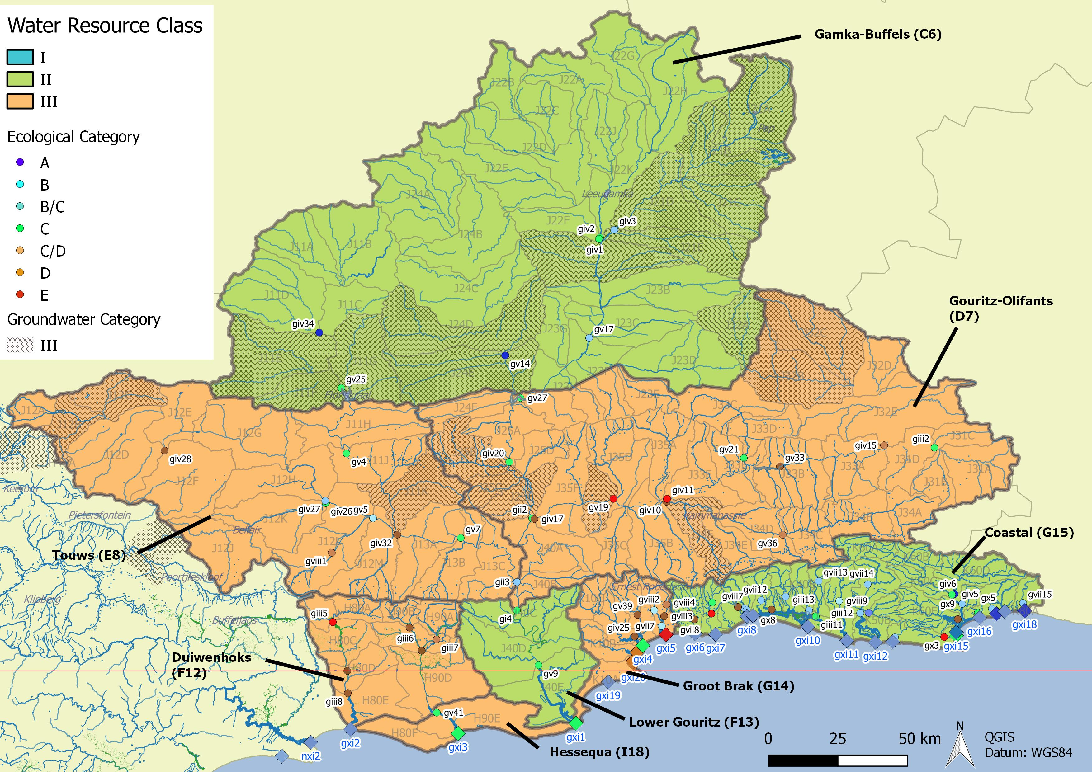
Integrated Units of Analysis and Nodes
Gouritz-Coastal Region

Slide 9
Gouritz-Coastal Region
Region | IUA |  | Spatially targeted
Gouritz Coastal | Gamka Buffels | C6 | II
 | Touws | E8 | III
 | Gouritz-Olifants | D7 | III
 | Lower Gouritz | F13 | II
 | Duiwenhoks | F12 | III
 | Hessequa | I18 | III
 | Groot Brak | G14 | III
 | Coastal | G15 | II

Slide 10
Determination of RQOs for estuaries in the Gouritz area
Notes:
Erik and team to present the methodology used for scenario evaluation

Slide 11
Outline
Estuaries in the Gouritz region
Prioritisation of estuaries for RQO development
Selection of indicators for monitoring
Numerical RQOs and narrative limits (examples)

Slide 12
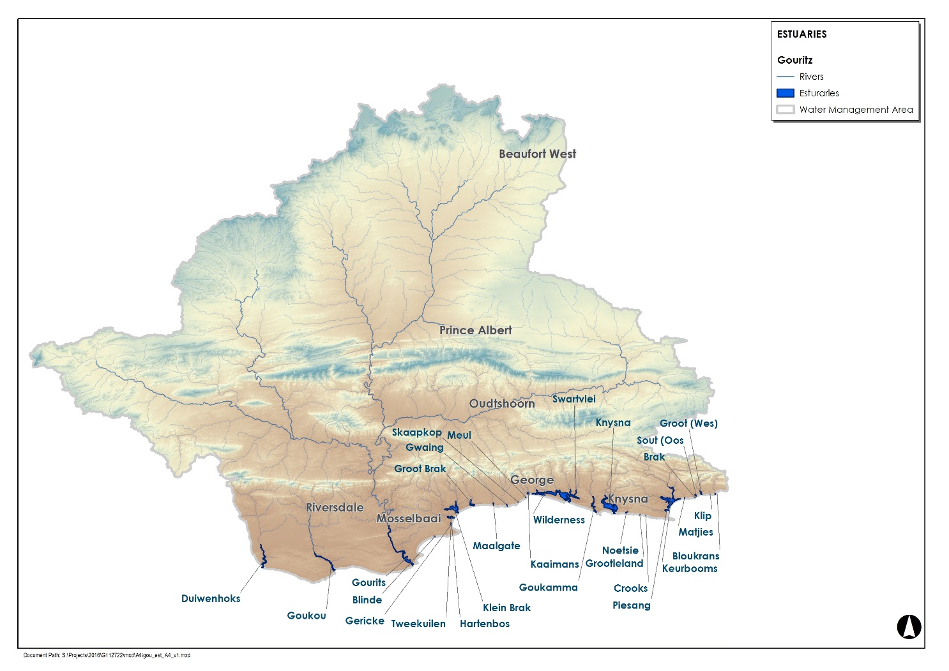
Estuaries in the Gouritz region

Slide 13
Estuaries in the Gouritz region
IUA | REC |  | Current |  | Target
 | REC | %nMAR | EC | %nMAR | EC | %nMAR
Duiwenhoks | A | 91.1 | B | 91.1 | B | 82.4
Goukou | B | 80.6 | C | 80.6 | C | 78.9
Gouritz | B | 71.5 | C | 64.6 | C | 47.4
Blinde | B | 98.0 | B | 96.3 | B | 68.8
Hartenbos | C | 64.3 | D | 83.2 | C | 80.7
Klein Brak | C | 89.9 | C | 89.9 | C | 76.5
Groot Brak | C | 58.5 | E | 58.5 | E | 53.8
Tweekuilen | D | 65.3 | D | 96.3 | D | 72.3
Gericke | D | 65.3 | D | 96.3 | D | 72.3
Maalgate | B | 96.3 | B | 96.3 | B | 80.0
Gwaaiing | B | 98.7 | B | 98.7 | B | 85.4
Kaaimans | B | 72.3 | B | 72.3 | B | 72.1
Wildernis | A | 88.5 | B | 88.5 | B | 88.5
Swartvlei | B | 90.9 | B/C | 90.9 | B/C | 77.8
Goukamma | A | 92.8 | B | 87.4 | B | 87.3
Knysna | B | 95.0 | B | 95.0 | B/C | 76.3
Noetsie | A | 91.7 | B | 91.7 | C | 65.1
Piesang | B | 91.7 | C | 91.7 | C | 72.3
Keurbooms | A | 87.3 | A | 87.3 | A/B | 77.3
Matjies | B | 91.1 | B | 91.1 | C | 63.5
Sout (Oos) | A | 91.1 | A | 91.1 | A | 85.0
Groot (Wes) | B | 91.1 | B | 91.1 | B | 86.2
Bloukrans | A | 91.8 | A | 91.8 | A | 97.9

Slide 14
Prioritisation of estuaries for RQO development
Priority estuaries were identified using two approaches:
  Estuary Importance Score (EIS) which is incorporated in the EWR methods for estuaries (initially completed in 2002 for all estuaries in SA, updated in numerous times thereafter)
  Resource Unit Prioritisation Tool (RUPT), published by DWA (2011)

Slide 15
Estuary Importance Score (EIS)
Criterion | Score (e.g.) | Weight
Size | 50 | 15
Zonal Type Rarity | 50 | 10
Habitat Diversity | 70 | 25
Biodiversity Importance | 88 | 25
Functional Importance | 60 | 25
ESTUARY IMPORTANCE SCORE = Weighted Mean | 70
Criteria for consideration | Guidelines for importance score
a Conduit for detritus, nutrients and sediments generated in the catchment to the sea | 0 none 20 little 40 some 60 important 80 very important 100 extremely important
b. Export of detritus and nutrients to the coastal zone generated within estuary
c. Nursery function for fish and crustaceans (marine and riverine)
d. Movement corridor for river invertebrates and fish breeding in marine environment (e.g. river crab Varuna litterata)
e. Roosting area for marine or coastal birds
Overall functional importance score | Max (a to e)

Slide 16
EIS Results
ESTUARY (West to East) | Plant | Invert | Fish | Bird | Biodiversity | Size | Habitat | Zonal Type Rarity | Importance Score* | Rank
Duiwenhoks | 60 | 100 | 70 | 80 | 76.5 | 100 | 90 | 20 | 83.6 | 23
Goukou | 80 | 90 | 70 | 80 | 79.0 | 90 | 90 | 20 | 80.3 | 31
Gourits | 90 | 80 | 80 | 90 | 88.0 | 90 | 60 | 20 | 75.0 | 49
Blinde | 100 | 40 | 10 | 60 | 77.5 | 10 | 10 | 10 | 26.9 | 216
Hartenbos | 100 | 70 | 40 | 80 | 86.5 | 70 | 60 | 10 | 65.6 | 75
Klein Brak | 70 | 80 | 70 | 60 | 69.0 | 80 | 10 | 10 | 52.8 | 115
Groot Brak | 80 | 100 | 70 | 80 | 79.5 | 90 | 80 | 10 | 76.9 | 46
Maalgate | 10 | 60 | 50 | 70 | 57.5 | 50 | 10 | 10 | 37.9 | 172
Gwaing | 10 | 40 | 10 | 10 | 11.5 | 10 | 10 | 10 | 10.4 | 254
Kaaimans | 50 | 50 | 40 | 30 | 45.5 | 30 | 10 | 20 | 27.9 | 210
Wilderness | 90 | 40 | 50 | 100 | 88.0 | 90 | 70 | 70 | 82.5 | 27
Swartvlei | 100 | 90 | 100 | 100 | 99.5 | 100 | 100 | 70 | 96.9 | 7
Goukamma | 50 | 100 | 90 | 80 | 83.0 | 70 | 40 | 10 | 59.8 | 59
Knysna | 100 | 100 | 100 | 100 | 100.0 | 100 | 100 | 100 | 100.0 | 1
Noetsie | 10 | 50 | 70 | 10 | 51.0 | 30 | 10 | 10 | 28.3 | 209
Piesang | 80 | 80 | 70 | 40 | 72.5 | 80 | 80 | 10 | 71.1 | 62
Keurbooms/Bitou | 100 | 90 | 80 | 90 | 95.0 | 100 | 90 | 20 | 88.3 | 18
Matjies | 10 | 40 | 10 | 100 | 70.0 | 10 | 10 | 10 | 25.0 | 220
Sout (Oos) | 70 | 80 | 70 | 50 | 67.5 | 70 | 50 | 20 | 59.4 | 91
Groot (Wes) | 100 | 70 | 40 | 60 | 83.5 | 70 | 50 | 10 | 62.4 | 84
Bloukrans | 90 | 40 | 10 | 10 | 63.5 | 70 | 10 | 50 | 51.4 | 120

Slide 17
Resource Unit Prioritisation Tool (RUPT)
Provision of cultural services to society
Provision of supporting livelihoods of significant vulnerable communities
Importance in meeting strategic requirements and international obligations
Provision of supporting and regulating services
Contributing to the economy (GDP and job creation) in the catchment (e.g. commercial agriculture, industrial abstractions and bulk abstractions by water authorities)
Level of threat posed to users
EIS category
Present ecological status
Priority in provincial / fine scale aquatic biodiversity plans
Level of threat posed to ecological components of the estuary
Estuaries with PES lower than a D Category or lower than the accepted gazetted category
Availability of EWR site data or other monitoring data (RHP, DWS gauging weirs etc.)
Accessibility of resource unit for monitoring
Safety risk associated with monitoring RUs.

Slide 18
RUPT Results
 | Gouritz | Duiwenhoks | Goukou | Blinde | Tweekuilen | Gericke | Hartenbos | Klein Brak | Groot Brak | Rooi | Maalgate | Gwaing | Skaapkop | Meul | Kaaimans | Wilderness
Position in IUA | 0.25 | 0.25 | 0.25 | 0.25 | 0.25 | 0.25 | 0.25 | 0.25 | 0.25 | 0.25 | 0.25 | 0.25 | 0.25 | 0.25 | 0.25 | 0.25
Concern for users | 0.18 | 0.18 | 0.16 | 0.13 | 0.07 | 0.07 | 0.20 | 0.20 | 0.20 | 0.00 | 0.09 | 0.07 | 0.00 | 0.00 | 0.10 | 0.25
Concern for environment | 0.23 | 0.19 | 0.19 | 0.11 | 0.06 | 0.06 | 0.17 | 0.19 | 0.19 | 0.00 | 0.08 | 0.08 | 0.00 | 0.00 | 0.08 | 0.25
Management and practical considerations | 0.10 | 0.20 | 0.10 | 0.05 | 0.08 | 0.06 | 0.10 | 0.10 | 0.25 | 0.02 | 0.05 | 0.05 | 0.02 | 0.02 | 0.07 | 0.13
Total Prioritization Score | 0.77 | 0.81 | 0.69 | 0.53 | 0.46 | 0.44 | 0.72 | 0.73 | 0.88 | 0.27 | 0.46 | 0.44 | 0.27 | 0.27 | 0.50 | 0.88
Priority Rating | 0.8 | 0.8 | 0.7 | 0.5 | 0.5 | 0.4 | 0.7 | 0.7 | 0.9 | 0.3 | 0.5 | 0.4 | 0.3 | 0.3 | 0.5 | 0.9
EIS Rank | 49 | 23 | 31 | 216 |  |  | 75 | 115 | 46 |  | 172 | 254 |  |  | 210 | 27
 | Swartvlei | Goukamma | Knysna | Noetsie | Grooteiland | Kranshoek | Crooks | Piesang | Keurbooms | Matjies | Brak | Sout (Oos) | Groot (Wes) | Sout (Oos) | Helpmekaars | Bloukrans
Position in IUA | 0.25 | 0.25 | 0.25 | 0.25 | 0.25 | 0.25 | 0.25 | 0.25 | 0.25 | 0.25 | 0.25 | 0.25 | 0.25 | 0.25 | 0.25 | 0.25
Concern for users | 0.25 | 0.18 | 0.25 | 0.01 | 0.00 | 0.00 | 0.00 | 0.13 | 0.19 | 0.02 | 0.00 | 0.01 | 0.13 | 0.00 | 0.00 | 0.01
Concern for environment | 0.25 | 0.19 | 0.25 | 0.00 | 0.00 | 0.00 | 0.00 | 0.19 | 0.25 | 0.00 | 0.00 | 0.00 | 0.05 | 0.00 | 0.00 | 0.00
Management and practical considerations | 0.10 | 0.10 | 0.25 | 0.08 | 0.02 | 0.02 | 0.02 | 0.10 | 0.10 | 0.05 | 0.02 | 0.02 | 0.10 | 0.02 | 0.02 | 0.05
Total Prioritization Score | 0.85 | 0.72 | 1.00 | 0.34 | 0.27 | 0.27 | 0.27 | 0.66 | 0.79 | 0.32 | 0.27 | 0.28 | 0.53 | 0.27 | 0.27 | 0.31
Priority Rating | 0.9 | 0.7 | 1.0 | 0.3 | 0.3 | 0.3 | 0.3 | 0.7 | 0.8 | 0.3 | 0.3 | 0.3 | 0.5 | 0.3 | 0.3 | 0.3
EIS Rank | 7 | 59 | 1 | 209 |  |  |  | 62 | 18 | 220 |  | 91 | 84 |  |  | 120

Slide 19
Selection of indicators for monitoring
Indicators for priority estuaries were identified through two means:
  RDM studies which generally include a list of indicators, and ecological specifications (Ecospecs) and Thresholds of Potential Concern (TPCs) for each indicator
  The Resource Unit Evaluation Tool (RUEV) published by DWA (2011)

Slide 20
Ecospecs & TPCs from RDM studies
 | Flow | Mouth condition and sedimentary processes | Water quality | Microalgae | Macrophytes (plants) | Invertebrates | Fish | Birds | Additional (non-flow related) interventions to achieve the TEC:
Duiwenhoks | ✔ | ✔ | ✔ | ✔ | ✔ | ✔ | ✔ | ✔ | ✔
Goukou | ✔ | ✔ | ✔ | ✔ | ✔ | ✔ | ✔ | ✔ | ✔
Gourits | ✔ | ✔ | ✔ | ✔ | ✔ | ✔ | ✔ | ✔ | ✔
Blinde | ✔ | ✔ | ✔ | ✔ | ✔ | ✔ | ✔ | ✔ | ✔
Hartenbos | ✔ | ✔ | ✔ | ✔ | ✔ | ✔ | ✔ | ✔ | ✔
Klein Brak | ✔ | ✔ | ✔ | ✔ | ✔ | ✔ | ✔ | ✔ | ✔
Groot Brak | ✔ | ✔ | ✔ | ✔ | ✔ | ✔ | ✔ | ✔ | ✔
Maalgate | ✔ | ✔ | ✔ | ✔ | ✔ | ✔ | ✔ | ✔ | ✔
Gwaing | ✔ | ✔ | ✔ | ✔ | ✔ | ✔ | ✔ | ✔ | ✔
Kaaimans | ✔ | ✔ | ✔ | ✔ | ✔ | ✔ | ✔ | ✔ | ✔
Wilderness | ✔ | ✔ | ✔ | ✔ | ✔ | ✔ | ✔ | ✔ | ✔
Swartvlei | ✔ | ✔ | ✔ | ✔ | ✔ | ✔ | ✔ | ✔ | ✔
Goukamma | ✔ | ✔ | ✔ | ✔ | ✔ | ✔ | ✔ | ✔ | ✔
Knysna | ✔ | ✔ | ✔ | ✔ | ✔ | ✔ | ✔ | ✔ | ✔
Noetsie | ✔ | ✔ | ✔ | ✔ | ✔ | ✔ | ✔ | ✔ | ✔
Piesang | ✔ | ✔ | ✔ | ✔ | ✔ | ✔ | ✔ | ✔ | ✔
Keurbooms/Bitou | ✔ | ✔ | ✔ | ✔ | ✔ | ✔ | ✔ | ✔ | ✔
Matjies | ✔ | ✔ | ✔ | ✔ | ✔ | ✔ | ✔ | ✔ | ✔
Sout (Oos) | ✔ | ✔ | ✔ | ✔ | ✔ | ✔ | ✔ | ✔ | ✔
Groot (Wes) | ✔ | ✔ | ✔ | ✔ | ✔ | ✔ | ✔ | ✔ | ✔
Bloukrans | ✔ | ✔ | ✔ | ✔ | ✔ | ✔ | ✔ | ✔ | ✔

Slide 21
Resource Unit Evaluation Tool (RUEV)
Activities that impact on the water resource | User groups
Afforestation | Commercial irrigated agriculture
Alien vegetation | Commercial livestock production
Artificial breaching or mouth stabilisation | Industrial users
Concentrated livestock operations | International users
Dams | Per-urban users
Dredging activities | Real estate and property
Dryland agriculture (including sugarcane & other crops) | Recreation and ecotourism
Industrial areas | Rural users
Infrastructure (including roads, powerlines etc) | Strategic users
Inter-basin transfers | Urban and residential users
Irrigated agriculture | Water Institutions
Livestock grazing | Other
Mining activities
Recreation and ecotourism
Rural Settlements practicing subsistence resource use
Sewage works and solid waste sites
Urban areas
Urban Informal settlements
Rehabilitation activities
Other

Slide 22
Resource Unit Evaluation Tool (RUEV)
 | Quantity |  | Hydro-dynamics |  | Quality |  |  |  |  |  |  | Physical habitat |  |  | Biota
 | Low Flows | High Flows (Floods) | Mouth Condition | Abiotic states | Salinity | Dissolved inorganic nitrogen | Dissolved inorganic phosphate | Water clarity | Dissolved oxygen | Toxic substances | Pathogens | Intertidal | Subtidal | Substrate type | Microalgae | Macrophytes | Invertebrates | Fish | Birds
Duiwenhoks | Y | Y | Y |  | Y | Y |  |  | Y |  | Y |  |  |  | Y | Y |  | Y | Y
Gouritz | Y | Y | Y |  | Y | Y |  |  | Y |  |  |  |  |  | Y | Y |  | Y | Y
Goukou | Y | Y | Y |  | Y | Y |  | Y | Y |  | Y |  |  |  | Y | Y | Y | Y | Y
Hartenbos | Y | Y | Y |  | Y | Y |  | Y | Y |  | Y |  |  |  | Y |  |  | Y | Y
Klein Brak | Y | Y | Y |  | Y | Y |  | Y | Y |  | Y |  |  |  | Y | Y | Y | Y | Y
Groot Brak | Y | Y | Y |  | Y | Y |  |  | Y |  | Y |  |  |  | Y | Y | Y | Y | Y
Wildernis | Y | Y | Y |  | Y | Y |  |  | Y |  | Y |  |  |  | Y | Y |  | Y | Y
Swartvlei | Y | Y | Y |  | Y |  |  |  | Y |  | Y |  |  |  | Y | Y |  | Y | Y
Goukamma | Y | Y | Y |  | Y | Y |  | Y | Y |  |  |  |  |  | Y | Y | Y | Y | Y
Knysna | Y | Y |  |  | Y | Y |  | Y | Y | Y | Y |  |  |  | Y | Y | Y | Y | Y
Piesang | Y | Y | Y |  | Y | Y |  | Y | Y |  | Y |  |  |  | Y | Y | Y | Y | Y
Keurbooms | Y | Y | Y |  | Y | Y |  | Y | Y |  | Y |  |  |  | Y | Y | Y | Y | Y

Slide 23
Estuary RQO Template
IUA |  |  | Node | Quat | REC | Current |  | Target
 |  |  |  |  |  | PES | %nMAR | EC | %nMAR
G14-Groot Brak |  |  | Gxi22 | K10B | C | D | 65.0 | C | 80.7
TEC SPECIFICATIONS
Flow | %nMAR: 80.7, dry season flow >0.05 Mm³/month
Mouth condition and sedimentary processes | % time mouth closed should not increase/decrease by >10% from present; no period of closure >3 months
Water quality | DIN not to exceed 200 μg/ℓ (average); DIP not to exceed 50 μg/ℓ (average)
Microalgae | Phytoplankton not to exceed 8 μg/ℓ (median), and/or 20 μg/ℓ (once-off) and/or cell density not to exceed 10 000 cells/ml (once-off) Benthic microalgae not to exceed 42 mg/m² (median)
Macrophytes (plants) | Maintain distribution of macrophyte habitats within 20% of present (Supratidal salt marsh: 29%, Reeds & sedges: 10%, sand/mud banks: 10%)
Invertebrates | Populations of key invertebrate species should not deviate from average baselines (as determined in first three visits) by more 30%
Fish | Relative contribution for key groups of fish (estuarine resident, marine migrant, freshwater, etc.) should not deviate from average baselines (as determined in first three visits) by more 30%
Birds | Number of birds in any group, other than species that are increasing regionally such as Egyptian geese, should not deviate by more than 30% from baseline median (determined by past data and or initial surveys)
Source of information |  | DWS (2015) Desktop Assessment of Estuaries in the Gouritz WMA
e.g. Hartenbos

Slide 24
IUA |  | Node | Quat | REC | Current |  | Target
 |  |  |  |  | PES | %nMAR | EC | %nMAR
G14-Groot Brak |  | Gxi22 | K10B | C | D | 65.0 | C | 80.7
TEC SPECIFICATIONS
Additional(non-flow related) interventions to achieve the TEC:
Dam construction has resulted in a reduction in base flow and floods to the system, with a shift in the onset of the high flow period and an increase in the duration of the low flow period; Artificial breaching; Loss of tidal flows and habitat as result of bridge construction (e.g. old N2, railway bridge); Infilling of estuary channel and mouth area as a result of loss of floods and artificial breaching; A significant reduction in water quality as a result of the Mossel Bay WWTW discharge and urban runoff; Development in the EFZ; Alien vegetation; Limited bait collection and fishing effort; and Human disturbance (which influences bird abundance).
Source of information | DWS (2015) Desktop Assessment of Estuaries in the Gouritz WMA

Slide 26
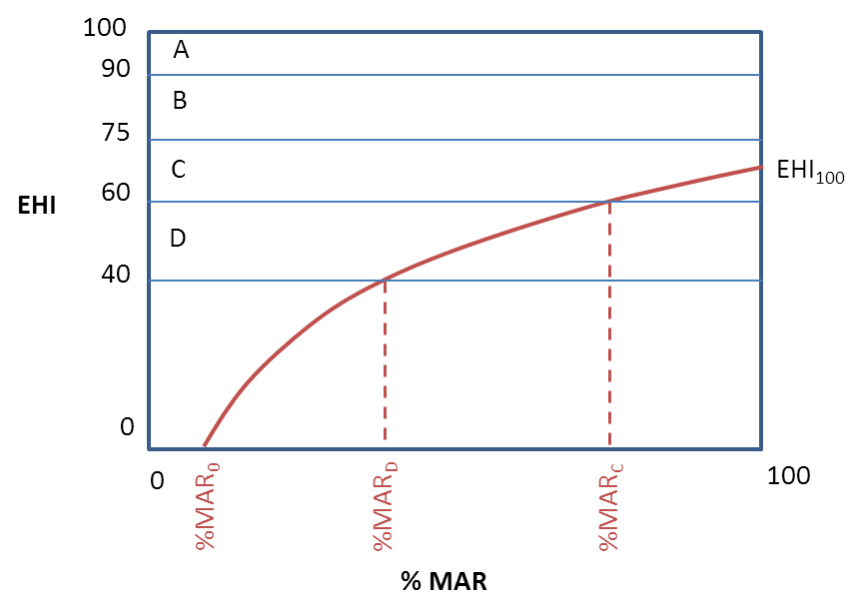
ESTUARIES
3. It is often not possible to restore health to 100% of natural through restoration of flow alone due to other non-flow related impacts
1. Relationship between health and flow is logarithmic – health declines increasingly rapidly as %MAR declines
A. Models were developed which allowed us to project likely changes in estuary health from A to E category as flows decline based on data from Reserve determination studies for individual estuaries
2. The ability of an estuary to support biodiversity drops to zero before MAR drop to zero
 |  | Assigned Ecological Category
 |  | A | B | C | D | E | F
PES | A | 1.0 | 0.9 | 0.7 | 0.5 | 0.3 | 0.1
 | B | 1.2 | 1.0 | 0.8 | 0.6 | 0.4 | 0.1
 | C | 1.4 | 1.2 | 1.0 | 0.7 | 0.4 | 0.1
 | D | 1.9 | 1.7 | 1.4 | 1.0 | 0.6 | 0.2
 | E | 3.2 | 2.8 | 2.3 | 1.7 | 1.0 | 0.3
 | F | 10.4 | 9.0 | 7.3 | 5.4 | 3.2 | 1.0
B. Proportional changes in the size of macrophyte, invertebrate, fish and bird populations were also estimated using matrices developed using data from Reserve determination studies for individual estuaries

Slide 27
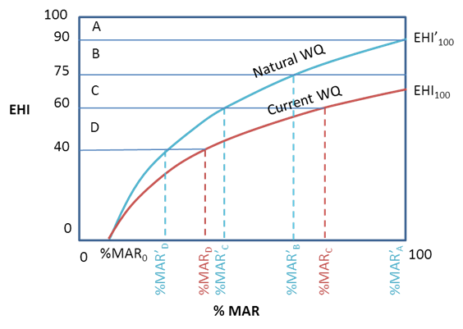
Determining EWRs for Estuaries
Model relationship between Estuary Heath Index (EHI) and changes in Mean Annual Runoff (MAR) and Water Quality

Slide 28
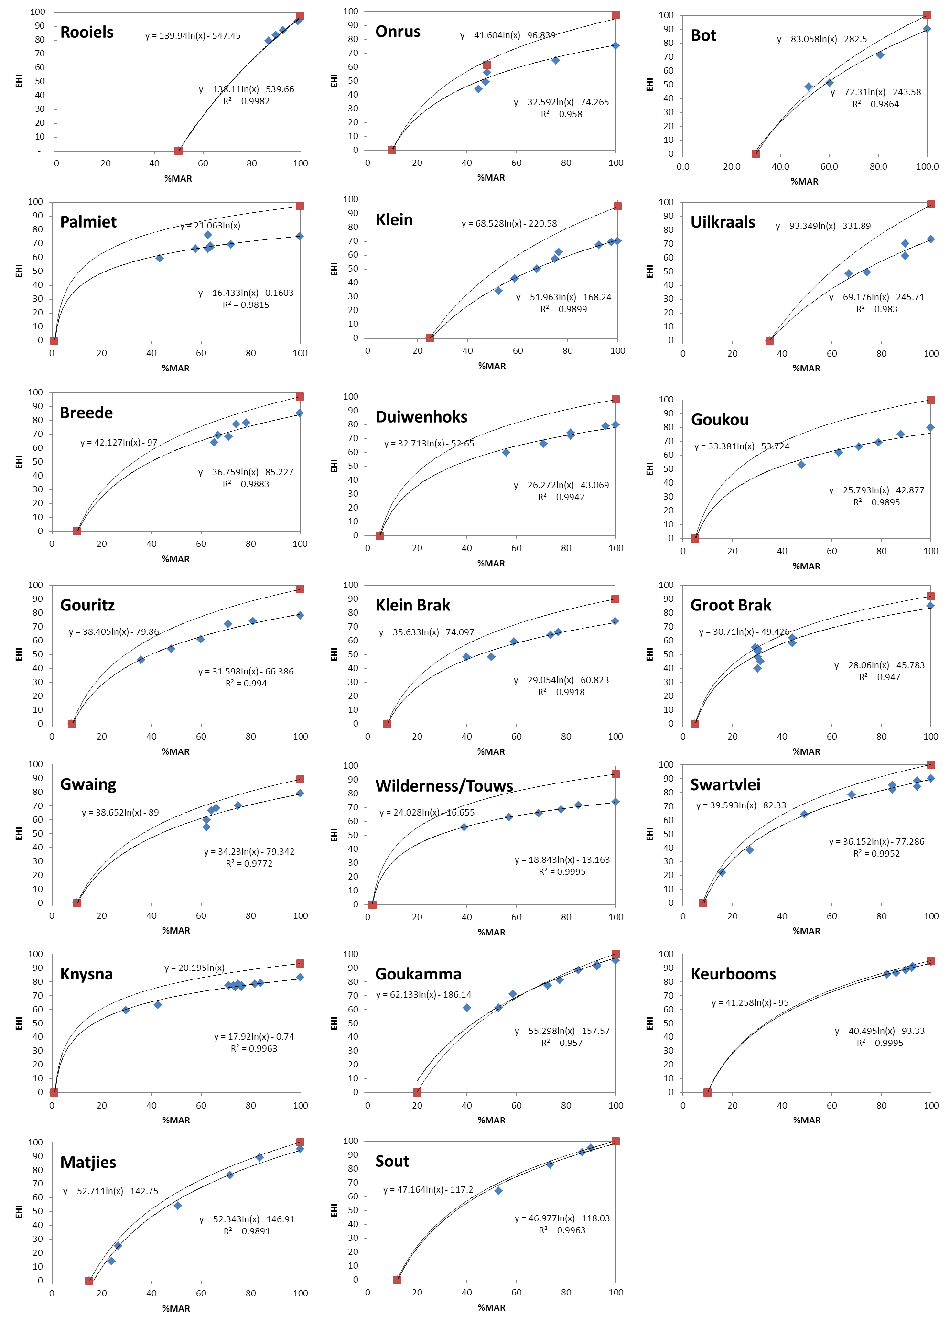
Change in EHI with MAR

